Slide 1

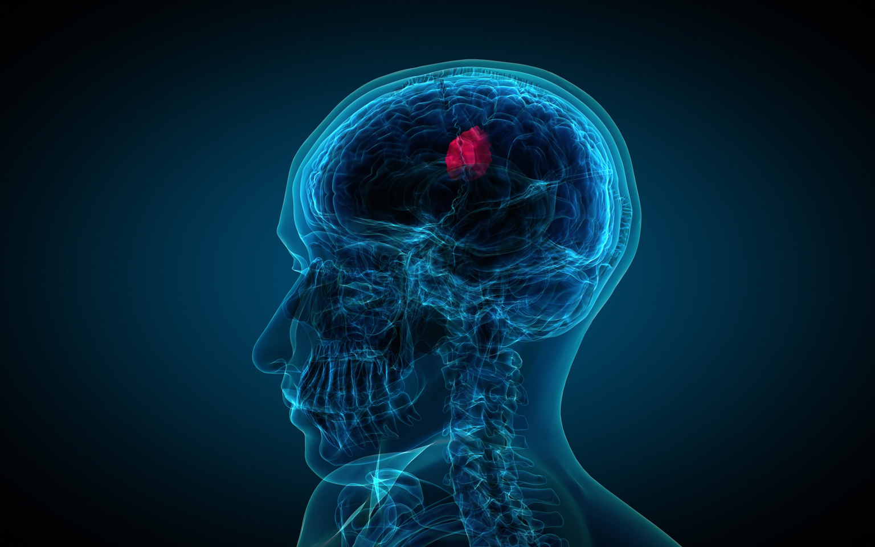
AI-Based Brain Tumor Segmentation from MRI Scans
By: Harsh Nishant Panchal (100816464), Vaishali Paraskar (100817086), Vidhi Patel (100784969)
Date: 05/12/2025
AI_700_SPRING2025

Slide 2

Outlines
Introduction
Research domain
Application
Literature Review result
Algorithm Approach
Understanding the functions
Visualization of Random data
Snapshot of code
Obtained Results
Conclusion and future work
References
2

Slide 3
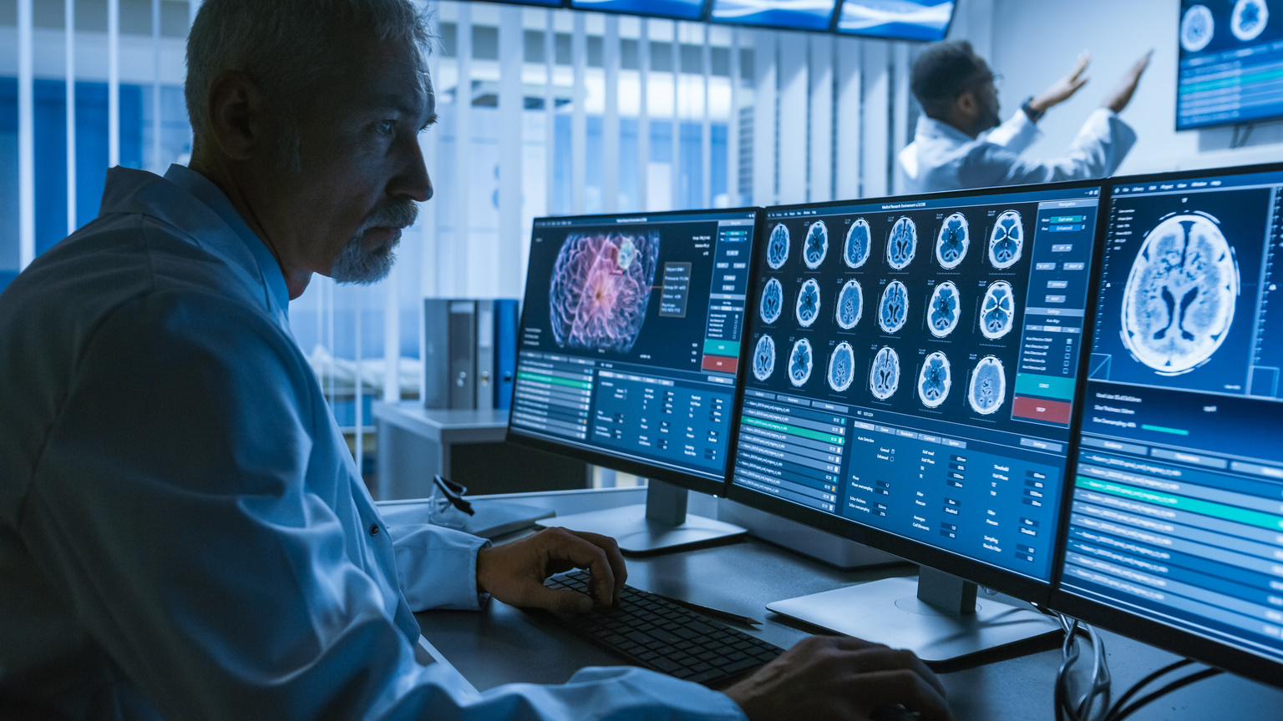
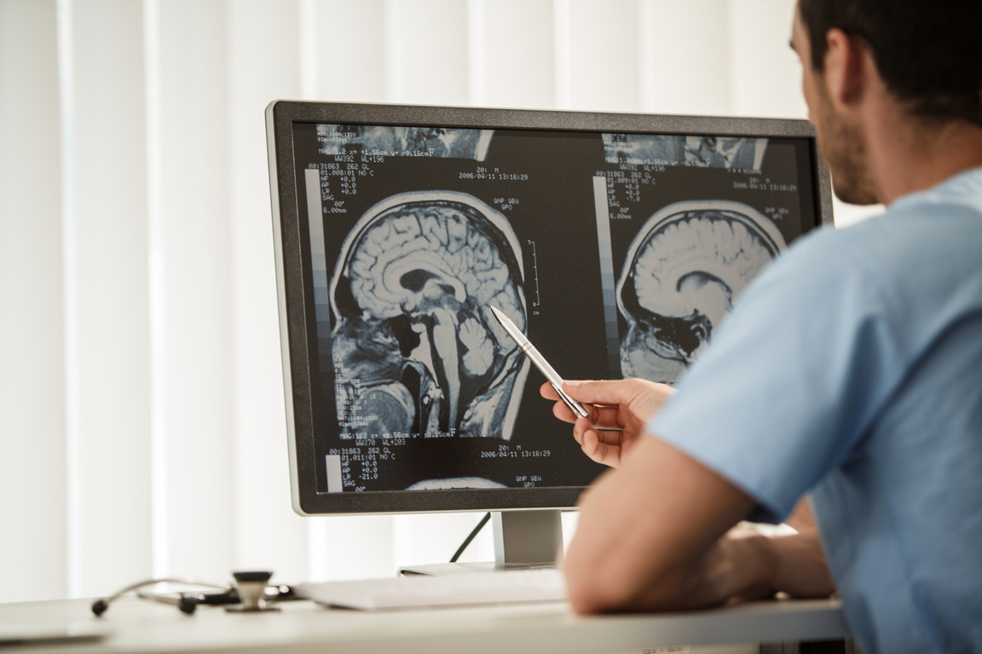
Introduction
Brain tumors pose a significant health risk, requiring early and precise diagnosis for effective treatment.
MRI scans are a primary tool for detecting brain tumors, but manual analysis is time-consuming and subject to variability.
AI-powered segmentation techniques enhance accuracy, efficiency, and consistency in tumor identification.
This research explores deep learning models for automated brain tumor segmentation.
Because brain tumors can be fatal, prompt and accurate MRI diagnosis is essential for successful therapy. While AI-powered deep learning models automate tumor segmentation, increasing speed, accuracy, and reliability, manual MRI analysis is unreliable and slow.
These algorithms help radiologists spot problems more quickly and objectively by analyzing structural and functional MRI data. CNNs, transformer-based architectures, and U-Net are important methods that have been trained on datasets such as BraTS.
AI-driven segmentation improves clinical decision-making and patient outcomes, however there are drawbacks, such as limited annotated data and model generalizability.
2

Slide 4
Research Domain
Brain tumor segmentation in MRI imaging presents significant challenges due to tumors irregular shapes, varying positions, and heterogeneous visual characteristics. Recent advances in Deep Neural Networks have revolutionized this field.
The research highlights that while CNNs and FCNs have been widely used, they suffer from gradient diffusion issues during training. The proposed Improved Residual Network ResNet addresses this by implementing shortcut connections that provide direct access to earlier layer information, significantly improving segmentation accuracy.
When tested on the BraTS2020 dataset, the Improved ResNet model achieved superior performance metrics compared to conventional CNN and FCN approaches, with over 10% improvement in accuracy, recall, and f-measure.
Brain tumor segmentation is critical for assisting radiologists in early detection and diagnosis.
Deep learning and AI have revolutionized medical imaging, providing automated solutions with high precision.
MRI scans offer detailed imaging, making them suitable for AI-driven tumor detection.
3

Slide 5
Applications
Early Diagnosis: AI models detect tumors at an early stage, improving patient outcomes.
Automated Segmentation: Reduces manual effort, enabling faster analysis and consistency.
Real-time Clinical Integration: AI-powered tools can be incorporated into hospital systems for real-time decision support.
Treatment Response Monitoring: AI models can track subtle changes in tumor size, shape, and composition across sequential MRIs, providing objective quantification of treatment effectiveness.
Surgical Planning: AI segmentation creates precise 3D tumor models, helping neurosurgeons plan optimal approaches, identify critical structures to avoid, and determine resection boundaries.
Radiation Therapy Targeting: Accurate tumor boundary delineation enables precise radiation delivery to maximize tumor coverage while minimizing damage to surrounding healthy brain tissue.
Clinical Trials Support: Automated segmentation ensures consistent measurements across multiple centers and timepoints, improving the reliability of drug efficacy evaluations.
4

Slide 6
Applications
Skull Stripping: Removing non-brain tissues like skull, eyes from MRI scans reduces noise and focuses the model on brain structures. Tools like FSL BET are commonly used.
Bias Field Correction: MRI scans can suffer from intensity inhomogeneities due to magnetic field variations. Techniques like N4 bias field correction help ensure uniform intensity across the brain.
Data Augmentation: To increase dataset size and model robustness, techniques like rotation, flipping, scaling, and elastic deformations are applied, especially since medical datasets are often limited.
Personalized Medicine: Integration with genetic and molecular data helps predict tumor behavior and treatment response, enabling more tailored therapeutic approaches.
4

Slide 7
Literature Review
Title of the Paper | Author(s) | Year | Result
An Early Detection and Segmentation of Brain Tumor using Deep Neural Network | Mukul Aggarwal, Amod Kumar Tiwari, M Partha Sarathi, Anchit Bijalwan | 2023 | The paper presents a deep neural network approach for early detection and segmentation of brain tumors in MRI scans. It demonstrates improved accuracy in identifying tumor boundaries and sub-regions using a CNN-based architecture.
Deep learning-integrated MRI brain tumor analysis: feature extraction, segmentation, and Survival Prediction using Replicator and volumetric networks | Deependra Rastogi, Prashant Johri, Massimo Donelli, Seifedine Kadry, Arfat Ahmad Khan, Giuseppe Espa, Paola Feraco & Jungeun Kim | 2022 | The paper explores an integrated deep learning framework for MRI brain tumor analysis, focusing on feature extraction, segmentation, and survival prediction.
Explainable artificial intelligence with UNet based segmentation and Bayesian machine learning for classification of brain tumors using MRI images. | K. Lakshmi, Sibi Amaran, G. Subbulakshmi, S. Padmini, Gyanenedra Prasad Joshi & Woong Cho | 2023 | The paper proposes an explainable AI framework combining UNet-based segmentation with Bayesian machine learning for brain tumor classification in MRI images.
6

Slide 8
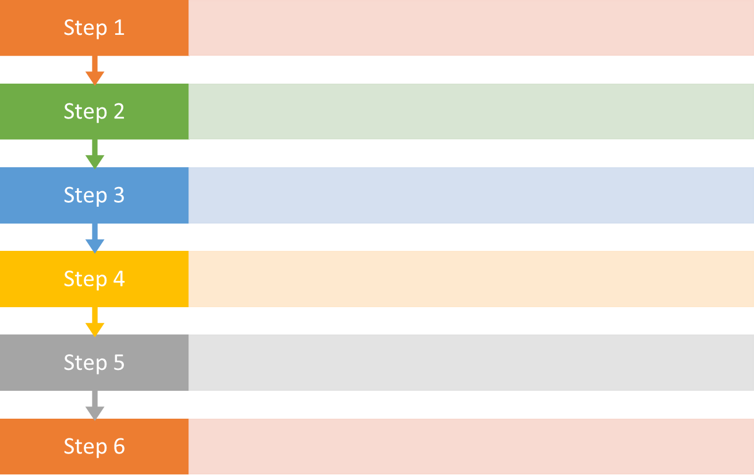
ALGORITHM/APPROACH
Data Collection and Preprocessing
Data Visualization
Model Selection & Training
Tumor Segmentation & Feature Extraction
Performance Evaluation & Validation
Cross-Validation and Deployment
7

Slide 9
Understanding the functions
Brain tumor segmentation in MRI scans plays a vital role in medical diagnostics, aiding in tumor detection, treatment planning, and patient prognosis. AI-driven models, particularly deep learning architectures like U-Net, ResNet and Transformer-based networks, have revolutionized segmentation accuracy by effectively learning spatial and textural features of tumors.
Data collection and preprocessing involve gathering multi-modal MRI scans from the BraTS dataset and preparing them through normalization, skull stripping, bias field correction, and data augmentation to address inconsistencies and noise while ensuring privacy compliance.
Data visualization inspects tumor characteristics through 2D slice overlays and histograms to address class imbalance and sub-region variability.
Model selection and training involve choosing models like 3D U-Net or TransUNet, training with Dice and focal loss on GPUs using PyTorch, and applying regularization.
Tumor segmentation and feature extraction use the model to segment tumors and sub-regions, extract features like volume and shape, and refine results with CRFs and morphological operations.
Performance evaluation and validation assess accuracy with metrics like Dice and Hausdorff, visualizing predictions to identify errors.
11

Slide 10
Understanding the functions
Cross-validation and deployment confirm robustness via 5-fold cross-validation, deploy the model with real-time capabilities and regulatory compliance and address generalization and bias challenges, supporting clinical applications like diagnosis and treatment planning, with future potential in federated learning and multi-task models.
Multimodal imaging fusion, incorporating sequences like T1, T2, FLAIR, and contrast-enhanced MRI, enhances segmentation by capturing diverse tumor characteristics, improving detection of tumor boundaries and sub-regions like edema, necrosis, and enhancing core.
Despite these advancements, challenges such as data heterogeneity, limited annotated datasets, and model generalization persist. Federated learning has emerged as a promising approach to train AI models across multiple healthcare institutions without sharing sensitive patient data, improving robustness and generalizability across diverse populations. Additionally, ensuring interpretability and trustworthiness in AI-based segmentation is crucial for clinical adoption.
11

Slide 11
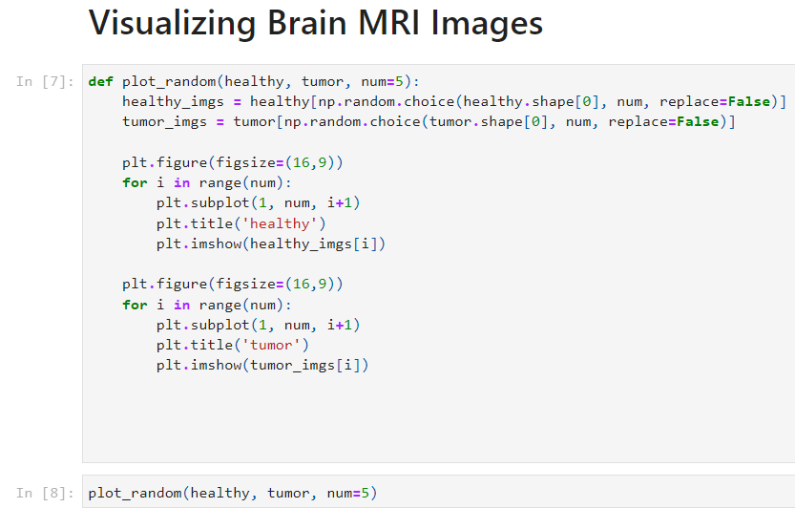
Snapshot of the code
Dataset Description: This study's dataset consists of MRI (Magnetic Resonance Imaging) scans of the brain obtained from patients with and without brain malignancies. Each image in the collection is labeled 'yes' or 'no' to indicate the presence or absence of a tumor.
Dataset Link: https://www.kaggle.com/navoneel/brain-mri-images-for-brain-tumor-detection
11

Slide 12
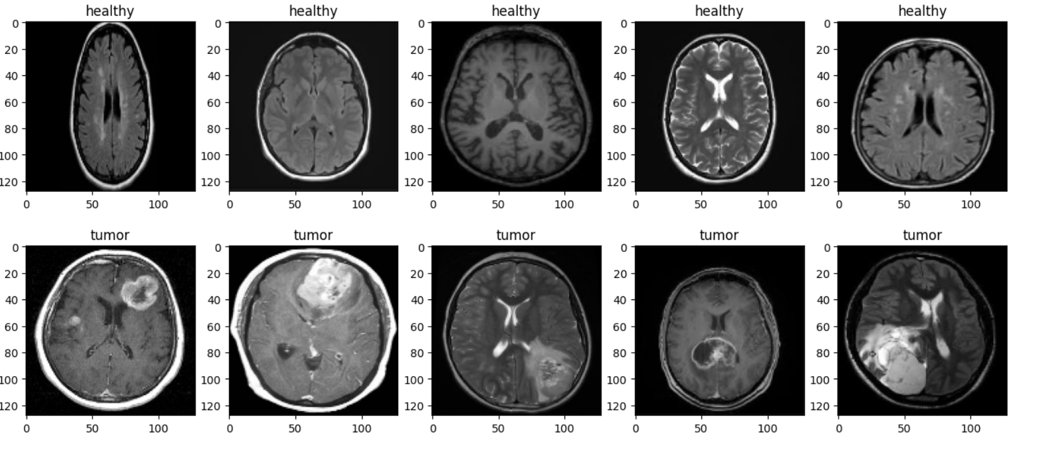
Visualization of Random data
11

Slide 13
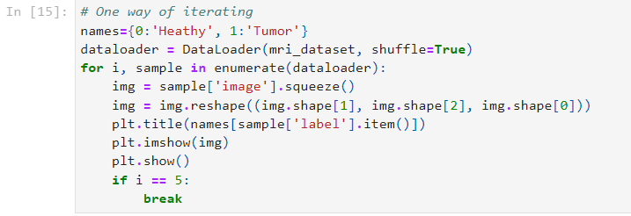
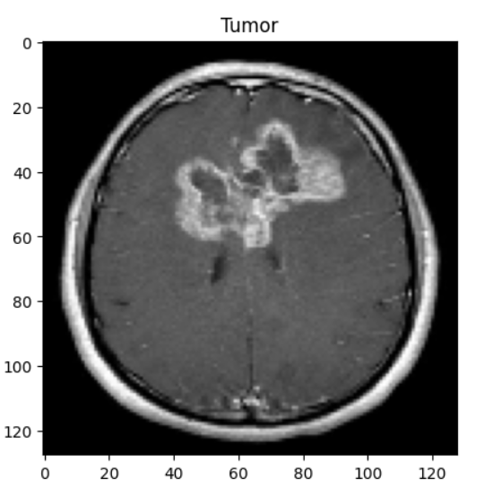
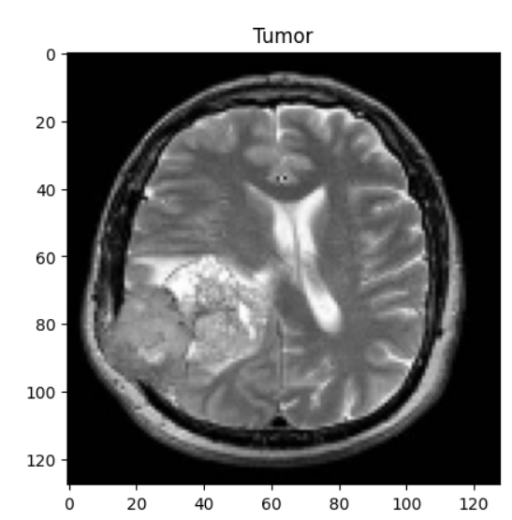
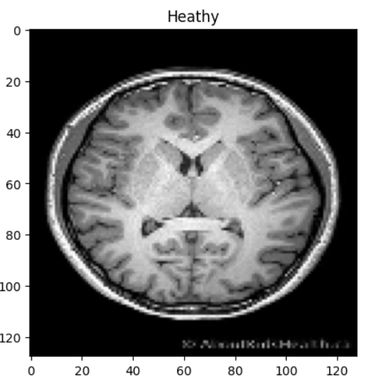
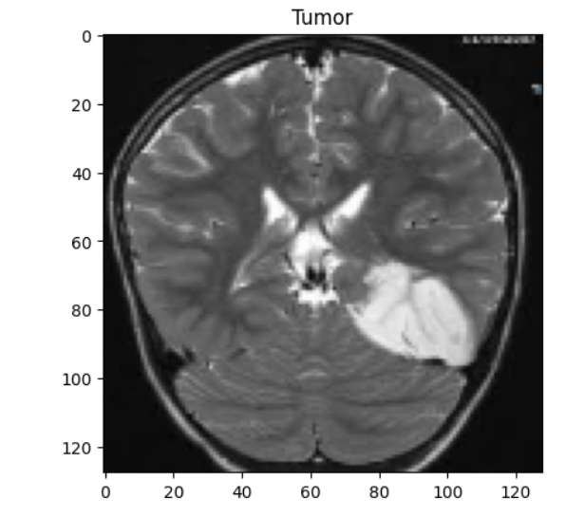
Snapshot of the code
Data loader:
11

Slide 14
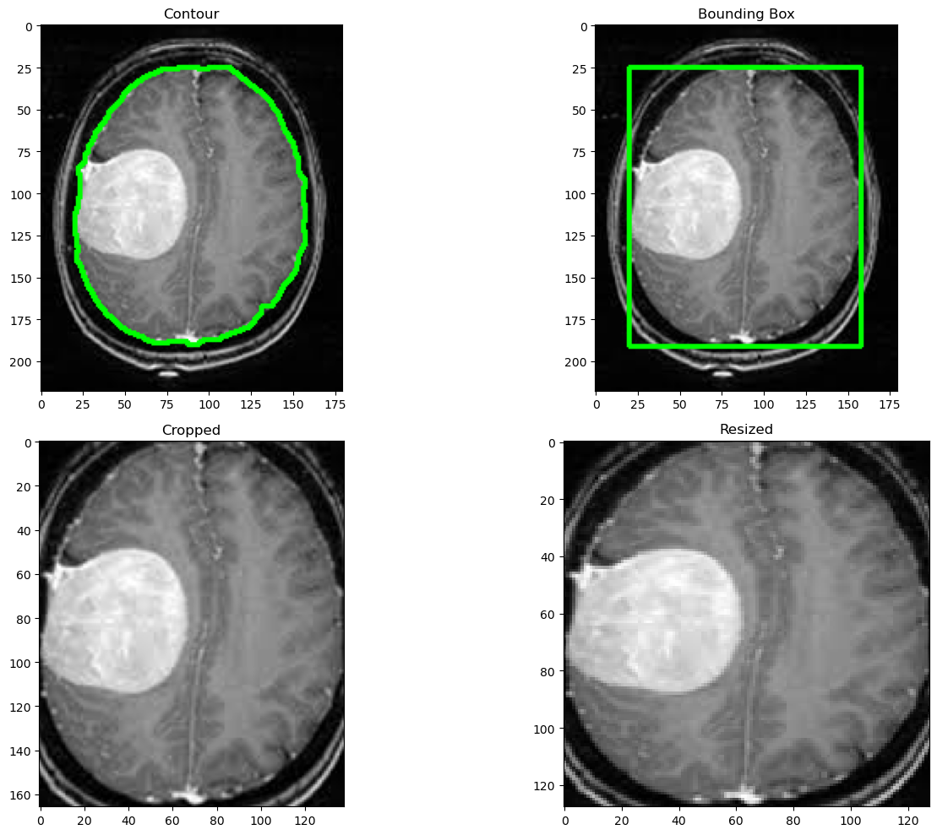
Brain Cropping Function
Brain Cropping Images through MRI scans:
11

Slide 15
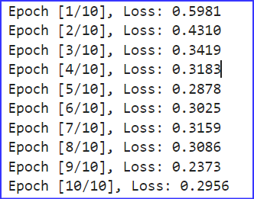
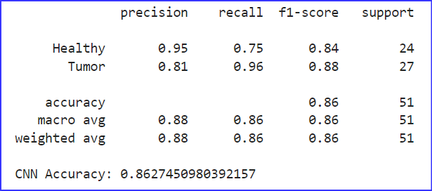
Convolutional Neural network (CNN)
Convolutional Neural Network Model:
Number of Epochs:
Classification Report:
11

Slide 16
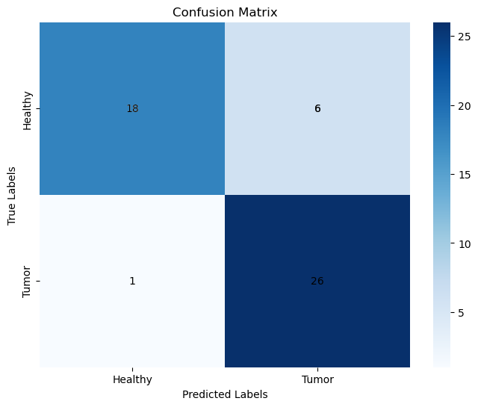
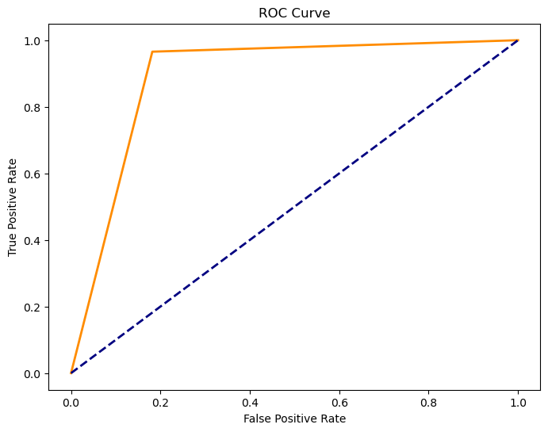
Convolutional Neural network (CNN)
Confusion Matrix (Heat Map) and Receiver Operating Characteristic Curve (ROC):
AUC Score | F-beta Score
0.86 | 0.88
11

Slide 17
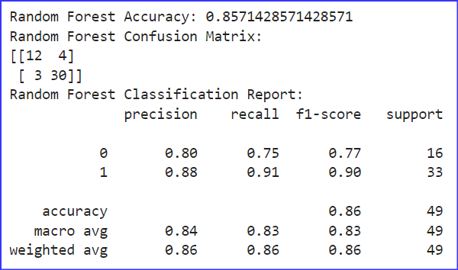
Random Forest Classifier
Random Forest Classifier Model:
Classification Report:
11

Slide 18
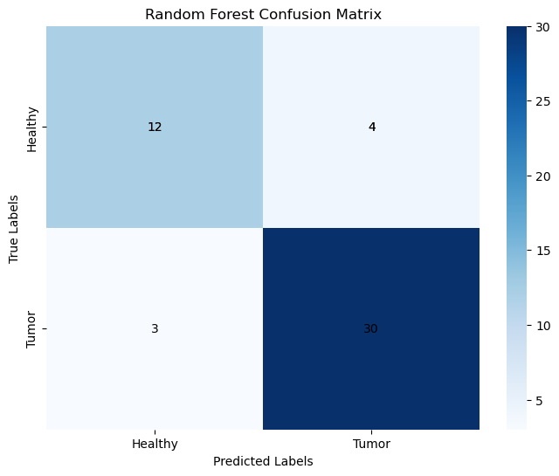
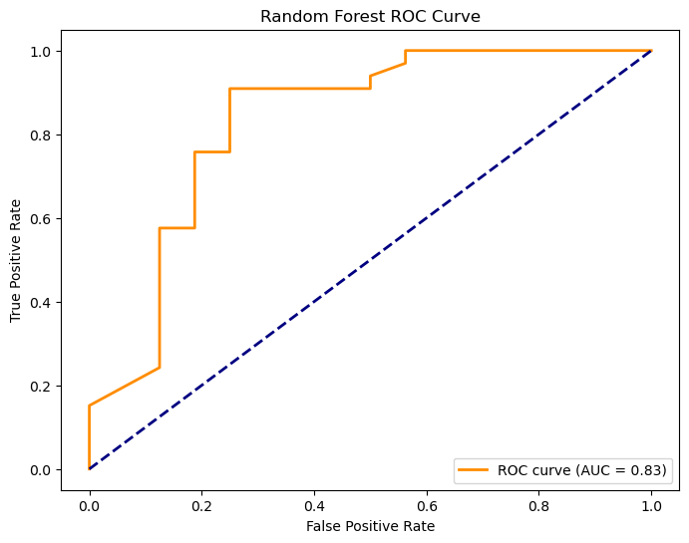
Random Forest Classifier
Confusion Matrix (Heat Map) and Receiver Operating Characteristics Curve (ROC):
AUC Score | F-beta Score
0.80 | 0.90
11

Slide 19
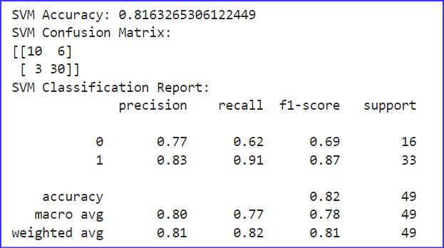
Support Vector Machines (SVM)
Support Vector Machine Model:
Classification Report:
11

Slide 20
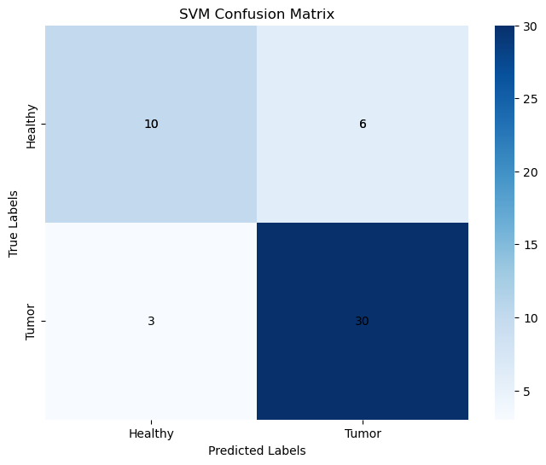
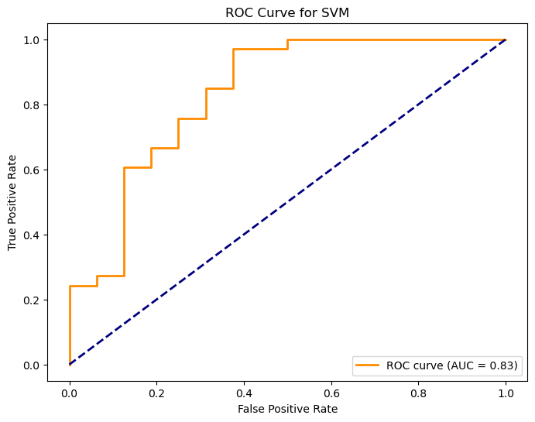
Support Vector Machines (SVM)
Confusion Matrix (Heat Map) and Receiver Operating Characteristics Curve (ROC):
AUC Score | F-beta Score
0.83 | 0.87
11

Slide 21
Obtained Results:
At this stage, Our preliminary results are shown below.
Classifier | Accuracy | Precision | Recall | F1-Score
CNN | 86% | 0.95 | 0.75 | 0.84
Random Forest | 86% | 0.80 | 0.75 | 0.77
SVM | 81% | 0.77 | 0.62 | 0.69
11

Slide 22
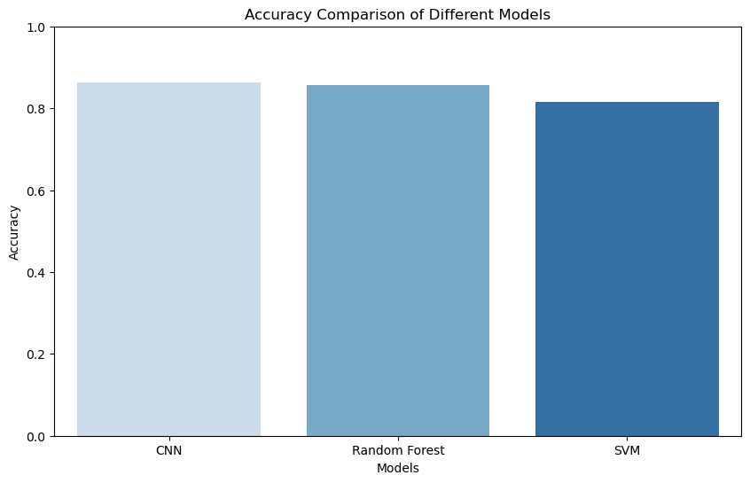
Comparison Plot
Comparison between model’s Accuracies:
11

Slide 23
Conclusion & Future Work
By facilitating quicker, more precise, and automated tumor identification in MRI scans, AI-driven brain tumor segmentation holds the potential to completely transform medical diagnostics. Segmentation accuracy has greatly increased as a result of advanced deep learning models, especially Transformer-based architectures and U-Net. Nevertheless, issues with clinical interpretability, model generalization, and data heterogeneity persist.
Future research should concentrate on improving segmentation accuracy by combining multimodal imaging techniques, creating federated learning strategies for more extensive generalization across various datasets while preserving privacy, and improving AI interpretability through explainable AI techniques in order to appeal to medical professionals.
By resolving these issues, AI-driven brain tumor analysis solutions will become more reliable, transparent, and therapeutically helpful, improving treatment planning and patient outcomes.
This expanded version elaborates on the document by quantifying the success of deep learning models, providing examples of Transformer and U-Net variants, and detailing challenges like overfitting and bias. It also offers concrete future directions, such as integrating multi-modal imaging, using federated learning, enhancing interpretability with Grad-CAM, and exploring GNNs, while emphasizing ethical and regulatory considerations to ensure clinical adoption. These additions provide a more comprehensive conclusion and actionable future steps for advancing AI-based brain tumor segmentation.
11

Slide 24
References
Litjens, G., Kooi, T., Bejnordi, B. E., et al. (2017). A survey on deep learning in medical image analysis. Medical Image Analysis, 42, 60-88.
Shen, D., Wu, G., & Suk, H. I. (2017). Deep learning in medical image analysis. Annual Review of Biomedical Engineering, 19(1), 221-248.
Singh, S. P., Raza, S. M., Verma, M., & Younis, M. Z. (2023). A review on medical image analysis using deep learning: Algorithms, applications, and future directions. International Journal of Medical Engineering and Informatics, 11, 1-17.
Xia, Y., Yan, L., & Feng, D. (2019). A survey on deep learning for medical image analysis. Neurocomputing, 397, 185-206.
Zhu, Y., Kim, M., Zhu, X., et al. (2021). Long-range early diagnosis of Alzheimer's disease using longitudinal MR imaging data. Medical Image Analysis, 67, 101825.
Ronneberger, O., Fischer, P., & Brox, T. (2015). U-Net: Convolutional networks for biomedical image segmentation. Medical Image Computing and Computer-Assisted Intervention (MICCAI). DOI:10.1007/978-3-319-24574-4_28
Akkus, Z., Galimzianova, A., Hoogi, A., et al. (2017). Deep learning for brain MRI segmentation. Journal of Digital Imaging, 30, 449-459. DOI:10.1007/s10278-017-9959-3
12

Slide 25

13

